Slide 1
Web Development
HTML and CSS

Slide 2

Web development
HTML and CSS

Slide 3
Chapter 4 Get user input using forms

Slide 4
OBJECTIVES
In this chapter you will learn how to:
Use forms to get user input.
Deploy various HTML elements to interact with users.

Slide 5



ListBox and dropdown lists
ListBox
Dropdown list
<select size="3">
<option>Java</option>
<option>C#</option>
<option>VB</option>
<option>PHP</option>
</select>
<select>
<option>Java</option>
<option>C#</option>
<option>VB</option>
<option>PHP</option>
<option>Ruby</option>
</select>

Slide 6


Radio buttons and checkboxes
<h3>Select a drink</h3>
<input type="radio" name="drink" value="t" />Tea
<input type="radio" name="drink" value="c" checked />Coffee
<input type="radio" name="drink" value="s" />Soup
<h3>Other options</h3>
<input type="checkbox" name="milk" value="y" />Milk
<input type="checkbox" name="sugar" value="y" />Sugar

Slide 7
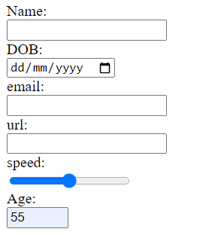
More user input elements
Name: <input type="text" name="name">
DOB: <input type="date" name="dob">
email:<input type="email" name="email">
url: <input type="url" name="url">
speed:<input type="range" name="speed">
Age: <input type="number" name="age" min="1" max="65">
Self-validating elements

Slide 8

Forms
Forms get information from the users to your server program:
Form element may have an action and method attribute (seen later).
Submit button will submit the form data.
<form action="Page2.html" method="get">
<input type="radio" name="drink" value="t" checked>Tea
<input type="radio" name="drink" value="c">Coffee
<input type="radio" name="drink" value="s">Soup<br />
<input type="checkbox" name="milk" value="y">Milk
<input type="checkbox" name="sugar" value="y">Sugar<br />
<input type="submit" value="Vend">
</form>

Slide 9
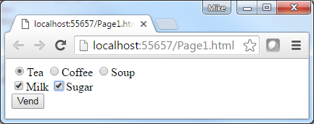

Forms – action and method attributes
<form action="Page2.html" method="get">
<form action="Page2.html" method="post">
Action:
Address where form's data is sent when submit is selected. (defaults to the same page.)
POST:
Form data placed in the body of the HTTP request. No size limitation. This method does not support bookmarking the result.
GET (default):
Information placed on the URL. limited by the browser URL max length, Users can edit it.

Slide 10
Cookies
Small data storage that is either stored in the client's browser memory or as text files on the client machine:
Useful for containing information about the user.
Limited to a session (session cookie) if not stored in permanent files.
Lifetime of the cookie can programmatically be set in code.
If saved as files they are easily accessible by clients / hackers.
Can only be read from the originator domain:
BBC.com cannot read cookies created by QA.com.
HTML5 provides other means of client-side storage mechanisms.
Server-side sessions are an alternative:
Store information for an IP address on the host server.
Cookies are strictly bound by law and any website using them needs permission from each user.

Slide 11
Summary
In this chapter you learned how to:
Create forms:
Method.
Use HTML elements to get the user input:
<form action="Page2.html" method="get">
<input type="radio" name="sex" value="f">Female
<input type="radio" name="sex" value="m" checked>Male
<input type="checkbox" name="CheckMilk" value="Yes">Milk
<input type="text">
<input type="number" min="1" max="9">
</form>

Slide 12
LAB
In this lab you will:
Gather student details using forms.
You will use the get and post methods.
Please refer to Get user input using Forms lab.
Duration 20 minutes.

